Slide 1




THERMO-MAP
SMART TEMPERATURE MAPPING FOR FARMING
Presented by: Tanish Parashar
Vishnu Hansda
Ananya Hota
Swastik Kumar Mohanty
Niranjan Kumar
Guided by: DR Ambarish G. Mohapatra

Slide 2
OVERVIEW
Abstract
Methodology
Introduction
Result
Problem Statement
Conclusion
Objectives
Reference

Slide 3
ABSTRACT
Optimal temperature is critical for mushroom yield and quality.
Manual monitoring is inconsistent and inefficient.
This project uses multiple IoT sensors.
Real-time data is collected, processed, and visualized for better climate control.
System reduces manual effort and ensures stable growing conditions.
Results show improved yield and cost-effective, data-driven farming.
Keywords: Smart Mapping, IoT Monitoring, Temperature Prediction(Future Implementation).

Slide 4
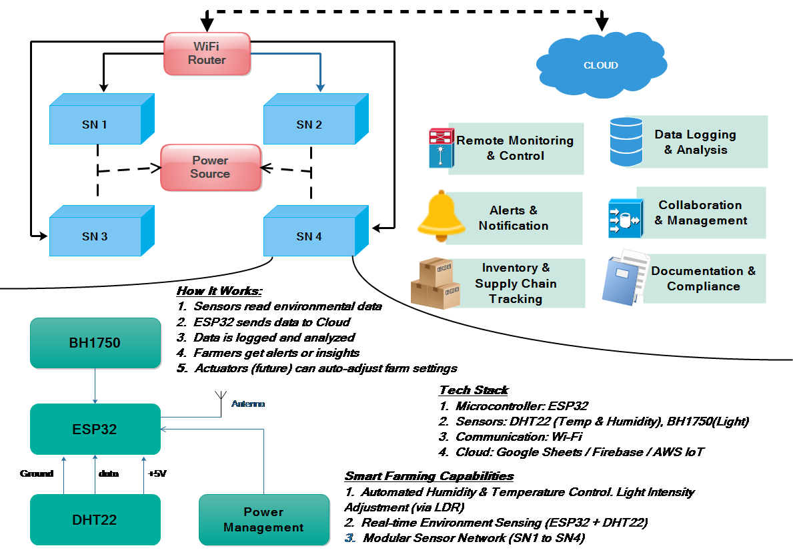
GRAPHICAL ABSTRACT

Slide 5
INTRODUCTION
Mushroom farming is highly sensitive to temperature fluctuations, which affect growth, yield, and quality.
Traditional monitoring methods rely on manual checks or few sensors, leading to poor temperature control.
This project introduces a smart system combining Machine Learning (ML) and IoT sensors for real-time monitoring and prediction.
Sensors like DHT11 are connected to an ESP32 microcontroller to collect environmental data.
Collected data is processed by an ML model to predict temperatures at unmeasured points.
A dynamic temperature map is generated for better climate control and decision-making.
The system reduces human effort, improves efficiency, and ensures optimal conditions for mushroom growth.

Slide 6
PROBLEM
Uneven Temperature Distribution: Traditional methods cannot accurately monitor the entire cultivation area.
Manual Monitoring Limitations: Human intervention leads to delayed responses and inconsistency in temperature control.
Limited Sensor Coverage: Few sensors result in incomplete temperature data, missing localized fluctuations.
Data Processing Challenges: Large volumes of raw sensor data require intelligent processing for actionable insights.
Delayed Response to Changes: Lack of real-time monitoring means harmful temperature shifts may go unnoticed.
Impact on Yield & Quality: Inconsistent climate conditions negatively affect mushroom growth, reducing yield and quality.

Slide 7
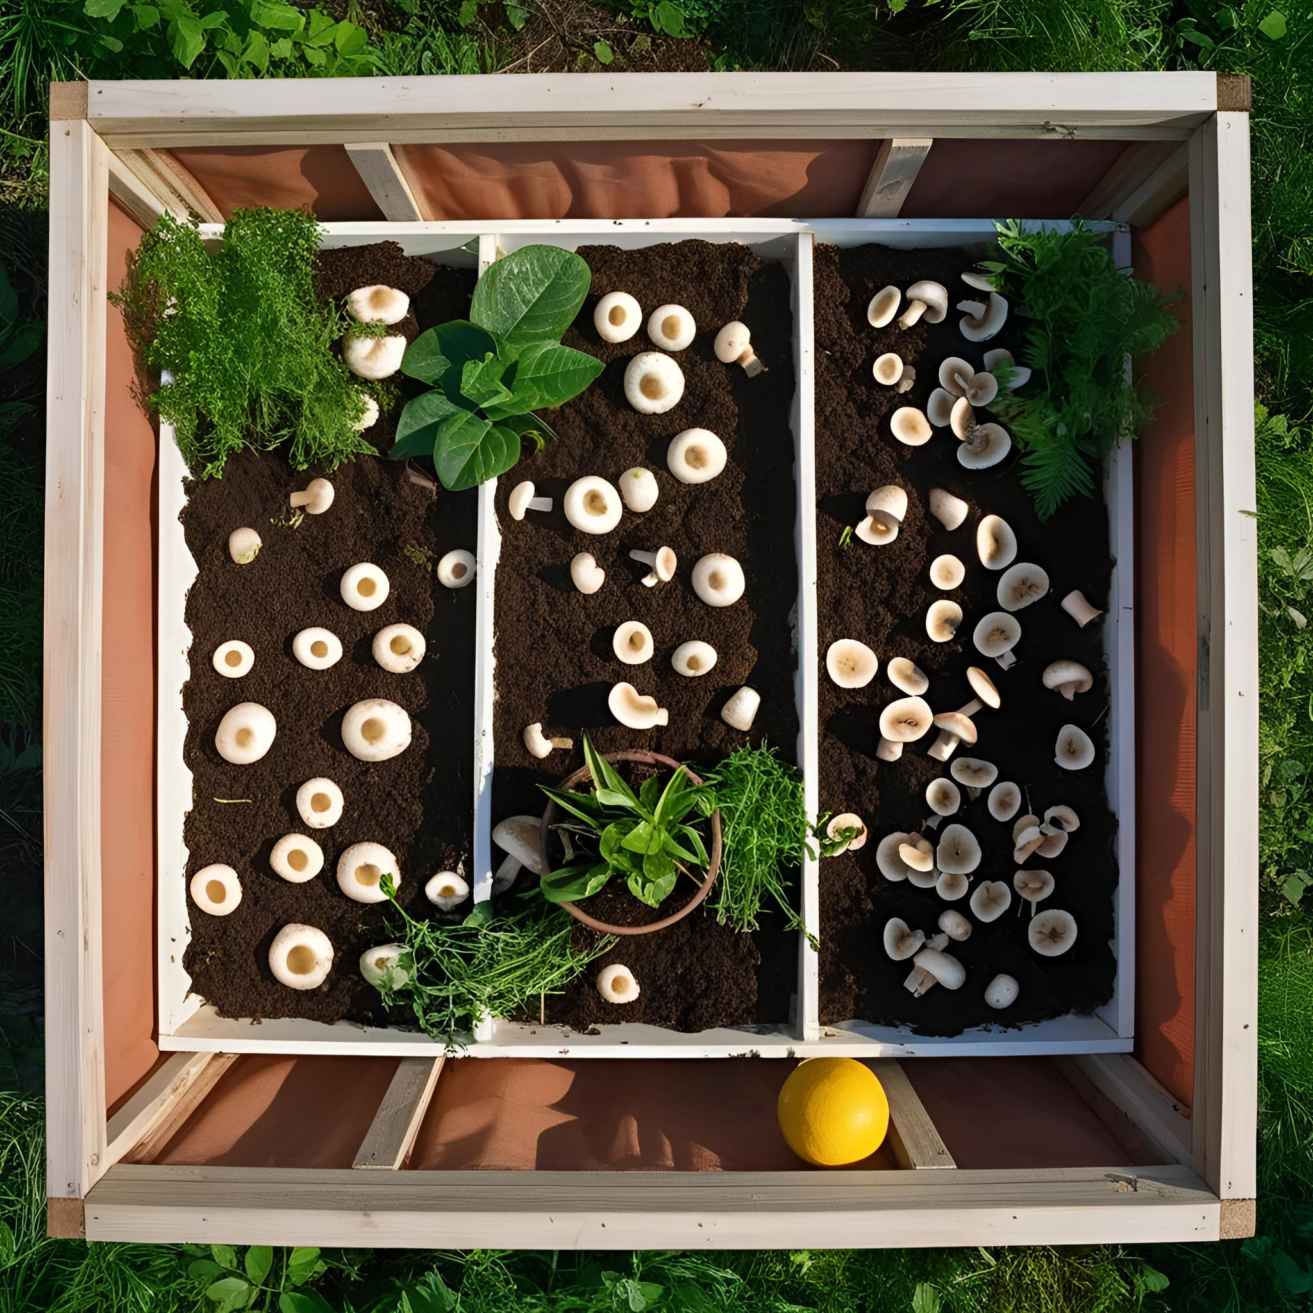

6. Plus, humans value our flavors.
5. Hey !!
At least we’re safer and can spread spores
Have you heard about those new farming techniques?
7. All this helps us thrive.
2. Yeah, temperature control and coffee grounds!
3. We’re like gourmet mushrooms now.
4. But what about our wild side?
8. Here’s to a bright future!

Slide 8
OBJECTIVE
Develop an automated temperature monitoring system for mushroom farming.
Integrate multiple sensors to collect real-time temperature data from various locations.
Use Machine Learning algorithms to predict temperatures at unmeasured points.
Generate a dynamic temperature map for accurate and visual representation.
Improve climate control efficiency to support optimal mushroom growth.
Reduce manual labor and support better decisions using data-driven insights.

Slide 9
METHODOLOGY
Sensor Deployment: Place multiple sensors (DHT11) in the cultivation area to measure temperature.
Data Collection: Use an ESP32 microcontroller to collect and transmit real-time sensor data.
Data Processing: Preprocess collected data to remove noise or inconsistencies.
ML Prediction: Apply Machine Learning techniques (e.g., regression, Kriging) to predict temperatures at unmonitored locations.
Temperature Mapping: Generate a comprehensive temperature map using predicted and real-time values.
Visualization: Display the temperature distribution via a user-friendly interface or dashboard.
Automated Control: Trigger alerts or adjust cooling/heating systems if temperatures deviate from optimal range.
Cloud Integration: Store and analyze data on the cloud for remote access and historical tracking.

Slide 10
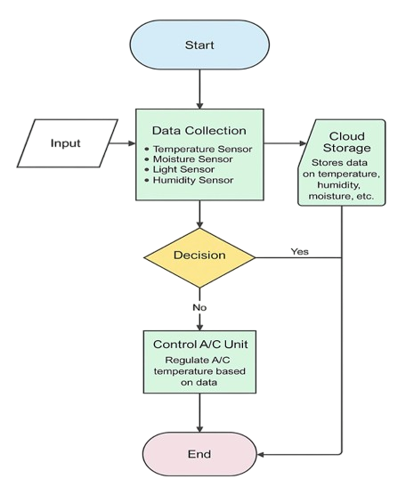
WORKFLOW

Slide 11

RESULT
Hardware Components:
ESP32 Microcontroller: Central unit for sensor data acquisition and Wi-Fi communication.
Sensors Used:
Temperature: DHT11
Humidity, Moisture, Light Sensors (optional for extended monitoring)
Connectivity: Wi-Fi enabled for cloud data transmission.
Software Components:
ML Model: Uses regression/Kriging for predicting unmeasured temperatures.
Data Visualizations: Real-time temperature heatmaps and dashboards for easy interpretation.
Cloud Platform: Stores sensor data, supports historical analysis, and enables remote monitoring.
Control Logic: Automatically adjusts AC or sends alerts when thresholds are crossed.

Slide 12
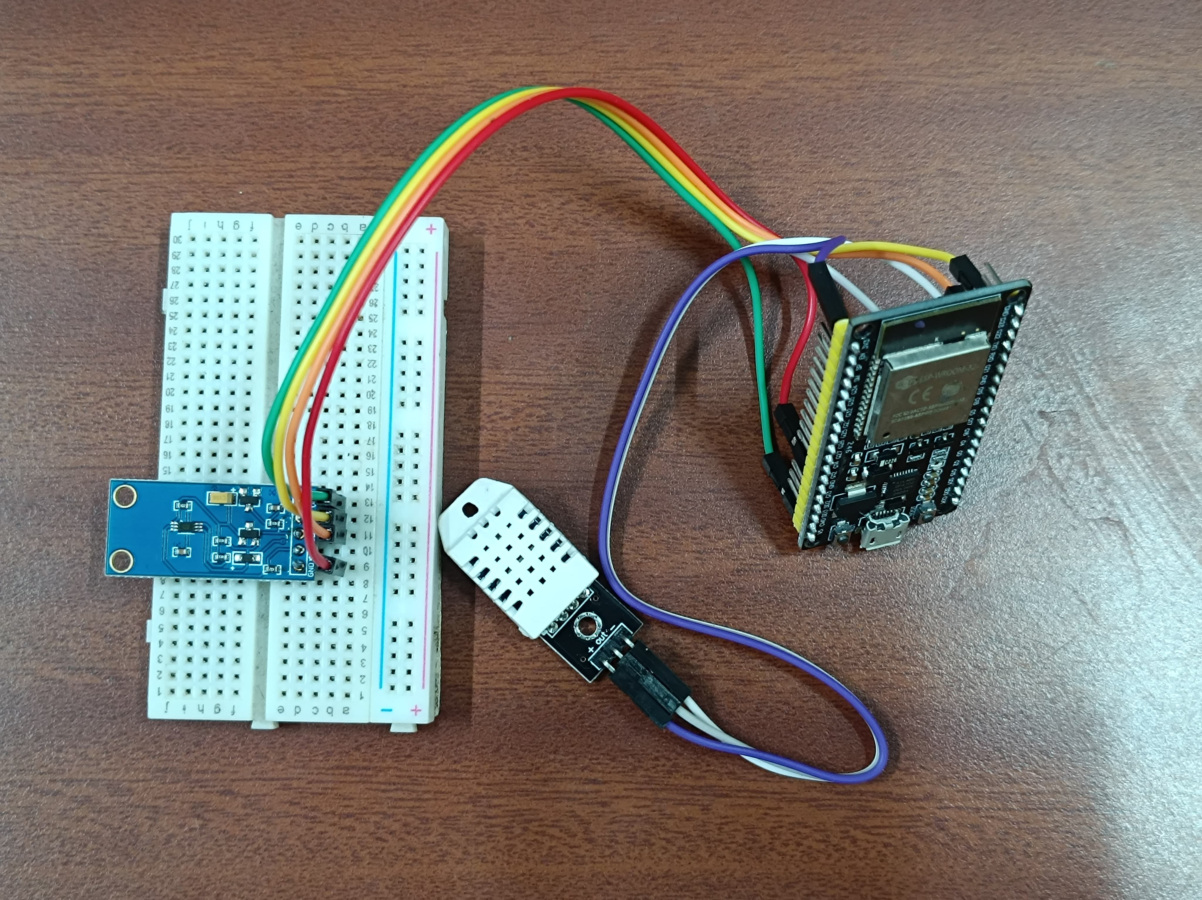
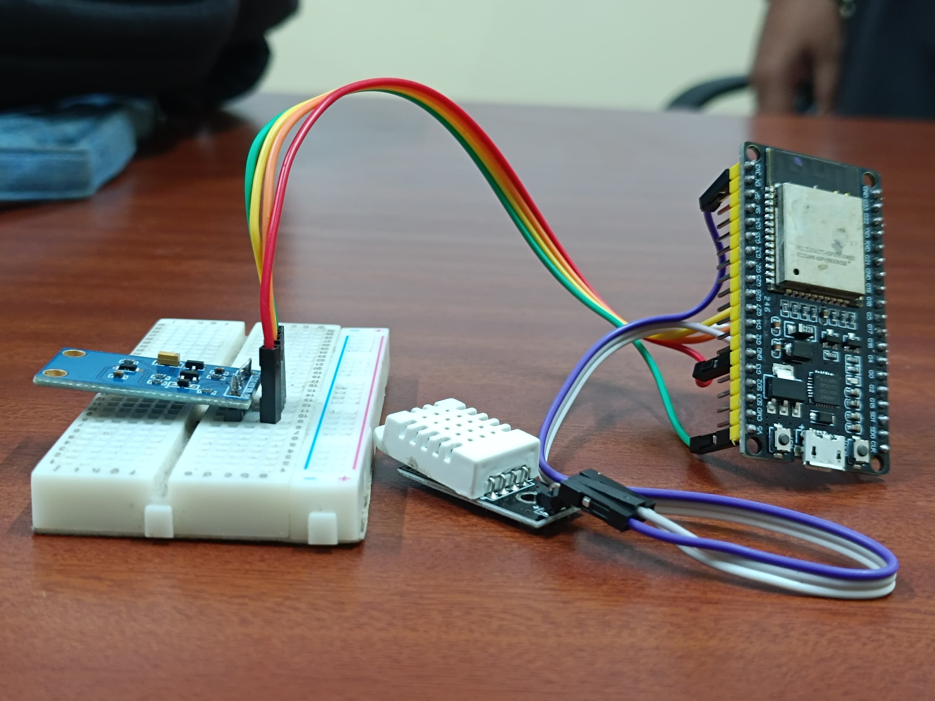
RESULT
Accurate prediction of temperature at unmonitored points.
Real-time visual temperature maps help identify critical zones.
Improved yield and consistency through proactive climate control.

Slide 13
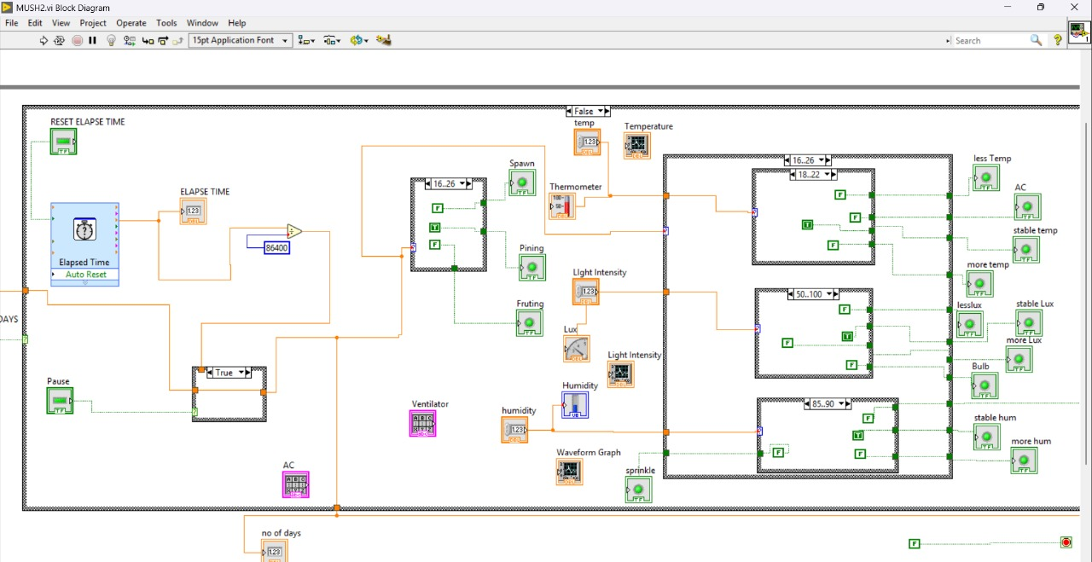
LABVIEW

Slide 14
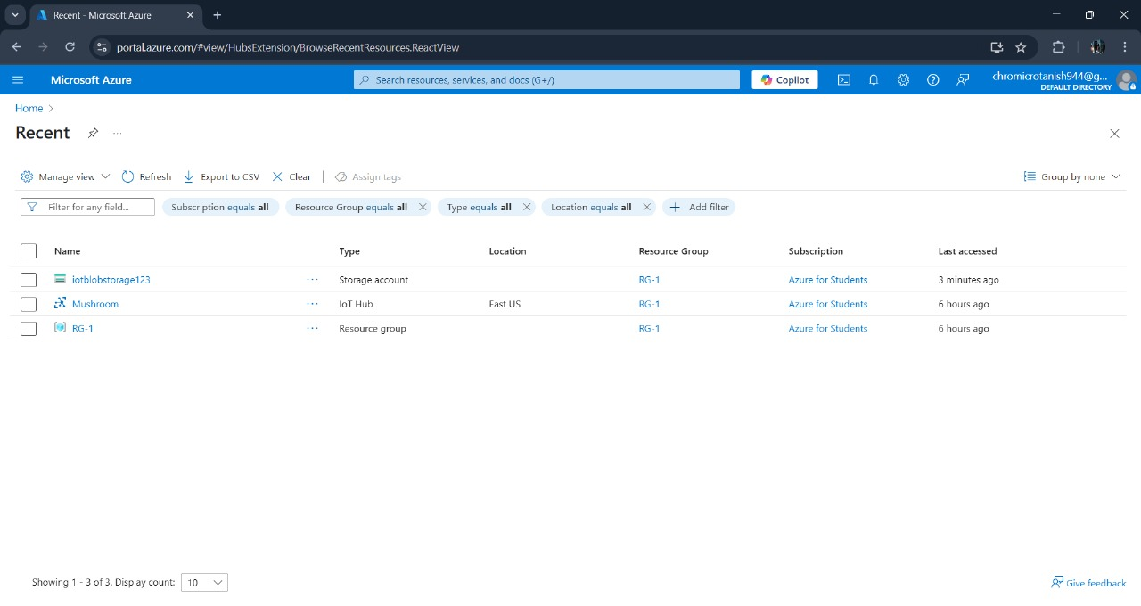
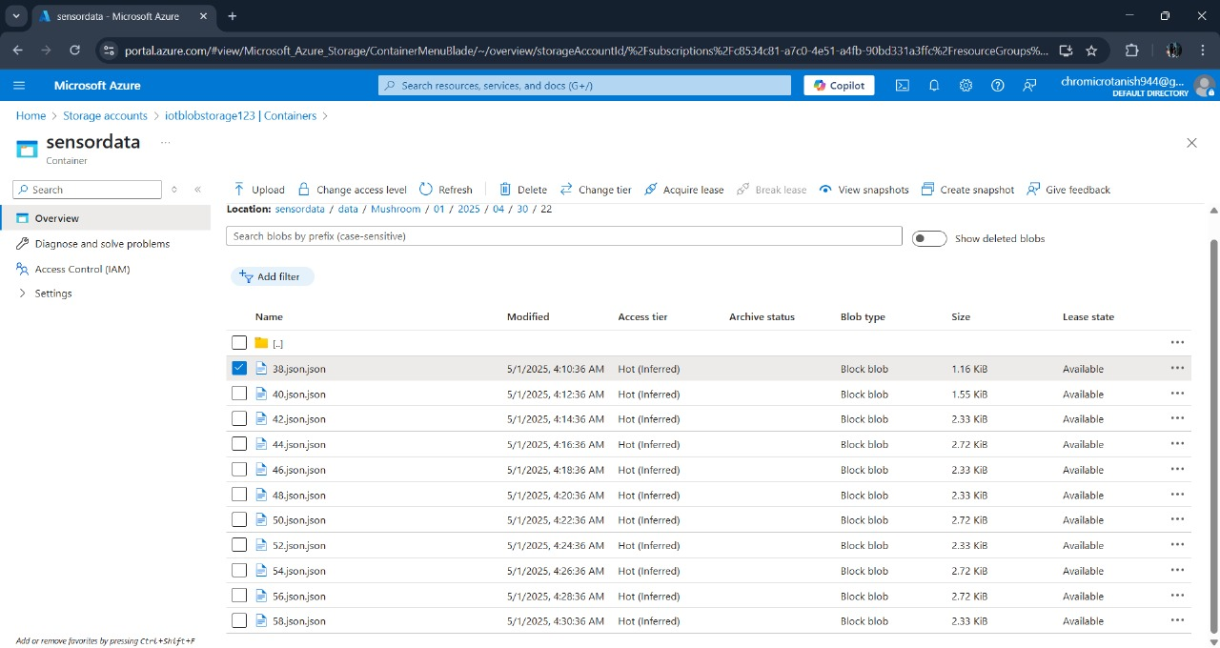
CLOUD

Slide 15
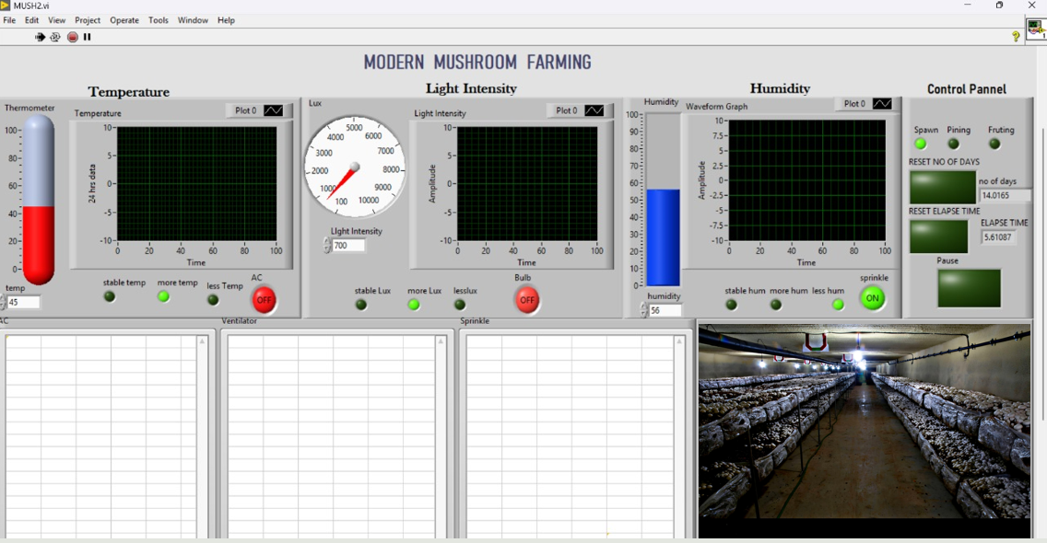
LABVIEW

Slide 16
CONCLUSION
The proposed system provides automated, real-time temperature monitoring for mushroom farming.
Integration of IoT sensors and ML enables accurate prediction of temperature across the cultivation area.
Dynamic temperature mapping helps maintain uniform environmental conditions.
Reduces manual effort and improves decision-making through data-driven insights.
Enhances yield quality and consistency by proactively managing temperature fluctuations.
Offers a cost-effective, scalable, and sustainable solution for precision agriculture.

Slide 17


DOCUMENTATION

Slide 18
REFERENCE
Li, M., Wang, X., & Wu, Q. (2020). Application of IoT and Wireless Sensor Networks in Precision Agriculture. IEEE Access, 8, 123456–123466.
Ahmed, S., & Kim, D. (2019). Kriging-based Spatial Interpolation for Smart Agriculture. Sensors, 19(14), 3085.
Espressif Systems. (2022). ESP32 Technical Reference Manual. Retrieved from: https://www.espressif.com/en/support/documents/technical-documents
Nallusamy, R., & Duraiswamy, K. (2018). Machine Learning Techniques for Smart Farming – A Review. International Journal of Engineering Research & Technology (IJERT), 7(5), 1–6.

Slide 19
Thank You

